Slide 1

AML-2203 Advanced Python AI and ML Tools
Lambton College
School of Computer Studies
[Prepared By: Vahid Hadavi, PhD]

Slide 2
Lecture2 2. Evaluate database and Python interactions
Major Topics:
2.1 Use Python modules to connect to a relational database
2.2 Use Python modules to interact with a relational database
2.3 Explore CRUD operations using Python and relational database
2.4 Use Python modules to connect to a non-relational database
2.5 Explore CRUD operations using Python and non-relational database

Slide 3
2.1 Use Python modules to connect to a relational database

Slide 4
Relational Databases
What is SQL?
SQL stands for Structured Query Language.
SQL database is a relational database.
A relational database consists of two or more tables with columns and rows.
Each row represents an entry, and each column sorts a very specific type of information, like a name, address, and phone number.
What can SQL do?
SQL can execute queries against a database
SQL can retrieve data from a database
SQL can insert records in a database
SQL can update records in a database
SQL can delete records from a database
SQL can create new databases
SQL can create new tables in a database

Slide 5
2.3 Explore CRUD operations using Python and relational database

Slide 6
CRUD
CRUD operation:
C: Create
R: Read
U: Update
D: Delete.

Slide 7
SQLite
In this tutorial, we will work with the SQLite3 database programmatically using Python.
SQLite in general is a server-less database that you can use within almost all programming languages including Python.
Server-less means there is no need to install a separate server to work with SQLite so you can connect directly with the database.
SQLite is a lightweight database that can provide a relational database management system with zero-configuration because there is no need to configure or set up anything to use it.
We will use SQLite version 3 or SQLite3, so let’s get started.

Slide 8
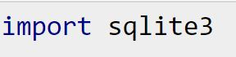
Create Connection:
To use SQLite3 in Python, first of all, you will have to import the sqlite3 module and then create a connection object which will connect us to the database and will let us execute the SQL statements.
You can create a connection object using the connect() function as follows:
That will create a new file with the name ‘example.db’ ….Now is the time to check our root directory and verify if example.db is generated !

Slide 9

Create (Con’d)
To execute SQLite statements in Python, you need a cursor object. You can create it using the cursor() method.
The SQLite3 cursor is a method of the connection object.
To Summarize, in order to execute the SQLite3 statements, you should establish a connection at first (as you did in the earlier slide) and then create an object of the cursor using the connection object as follows:
Now we can use the cursor object to call the execute() method to execute any SQL queries (Next slide)

Slide 10
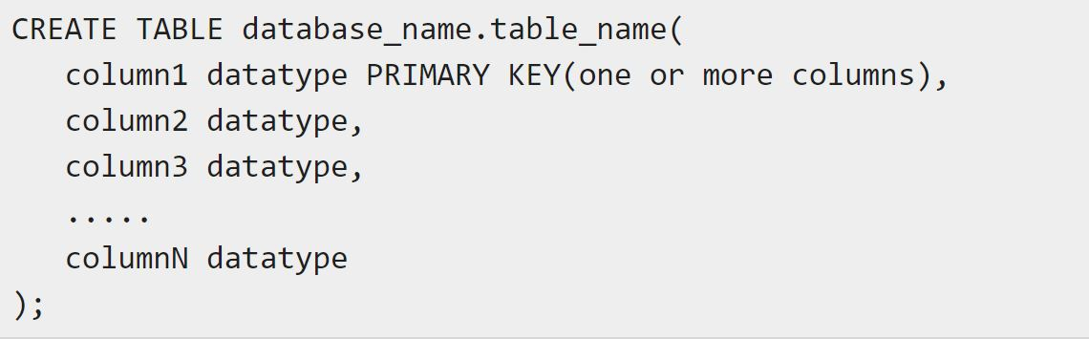
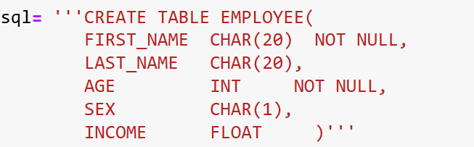
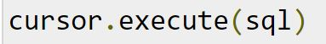
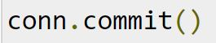
Create a Table
Now we can execute the CREATE TABLE statement using the execute() method of the Cursor class
It is important to call commit() method after every transaction that modifies data.

Slide 11
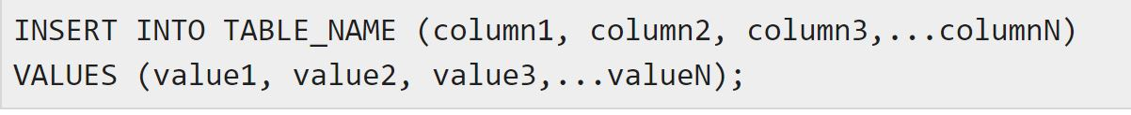
Insert
We can add new rows to an existing table of SQLite using the INSERT INTO statement.
In this, we need to specify the name of the table, column names, and values (in the same order as column names).
Statement:

Slide 12
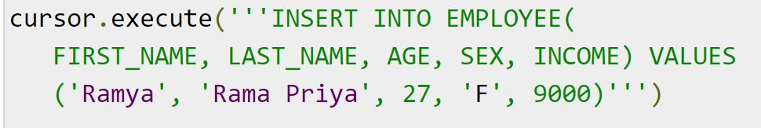
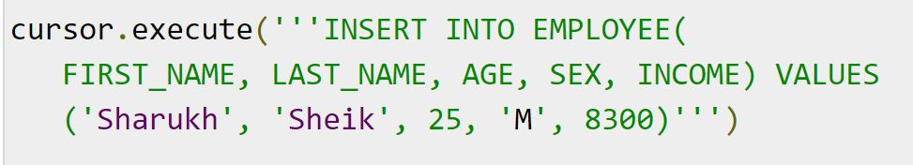
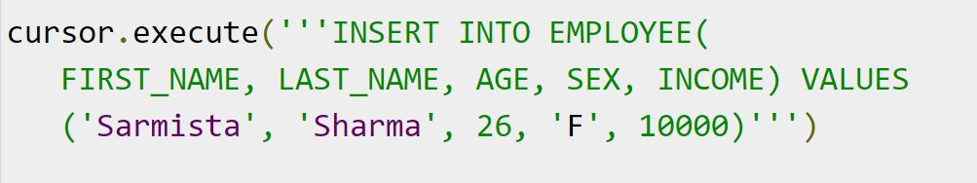
Insert
We have to use commit() method after exciting the insert statements.
Challenge question: How can we insert all entries in one single step? Explore it!

Slide 13
Read
We can retrieve the contents of an existing table using the SELECT statement.
At this statement, we need to specify the name of the table and, it returns its contents in tabular format which is known as result set.
Statement:
The sqlite3.Cursor class provides three methods namely fetchall(), fetchmany() and, fetchone() to fetch the selected rows:
The fetchone() method fetches the next row in the result of a query and returns it as a tuple
The fetchmany() method is similar to the fetchone() but, it retrieves the next set of rows in the result set of a query, instead of a single row.
The fetchall() method retrieves all the rows in the result set of a query and returns them as list of tuples. (If we execute this after retrieving few rows it returns the remaining ones).

Slide 14
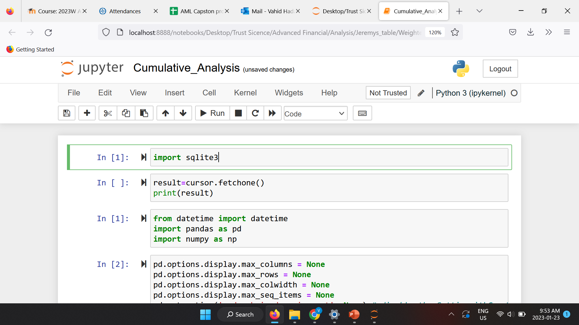
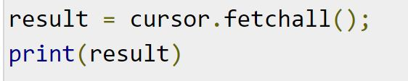
Read
fetchone :
fetchall :

Slide 15
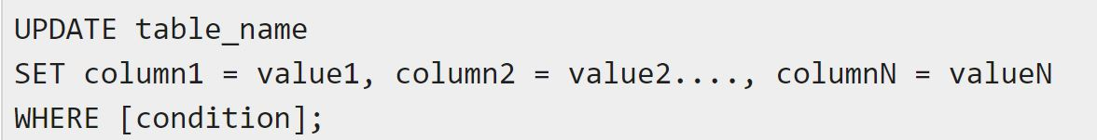
Update
UPDATE Operation on any database implies modifying the values of one or more records of a table, which are already available in the database.
We can update the values of existing records in SQLite using the UPDATE statement.
To update specific rows, you need to use the WHERE clause along with it
Statement:
Check output

Slide 16
Delete
To delete records from a SQLite table, you need to use the DELETE FROM statement.
To remove specific records, you need to use WHERE clause along with it.
Statement:
Challenge Question : Remove one of the Columns from your table!

Slide 17
2.4 Use Python modules to connect to a non-relational database

Slide 18
Non-Relational Databases
What is NoSQL?
NoSQL stands for non-Structured Query Language.
NoSQL database is a non-relational database.
They are document databases, key-value databases, wide-column stores, and graph databases.
NoSQL databases can store relationship data—they just store it differently than relational databases do.
What can NoSQL do?
NoSQL can execute queries against a database
NoSQL can retrieve data from a database
NoSQL can insert records in a database
NoSQL can update records in a database
NoSQL can delete records from a database
NoSQL can create new databases

Slide 19
Install MongoDB
Tutorial :
https://www.youtube.com/watch?v=FwMwO8pXfq0
Download link:
https://www.mongodb.com/try/download/community
Nice read :
https://www.geeksforgeeks.org/connecting-mongodb-to-jupyter-notebook/

Slide 20
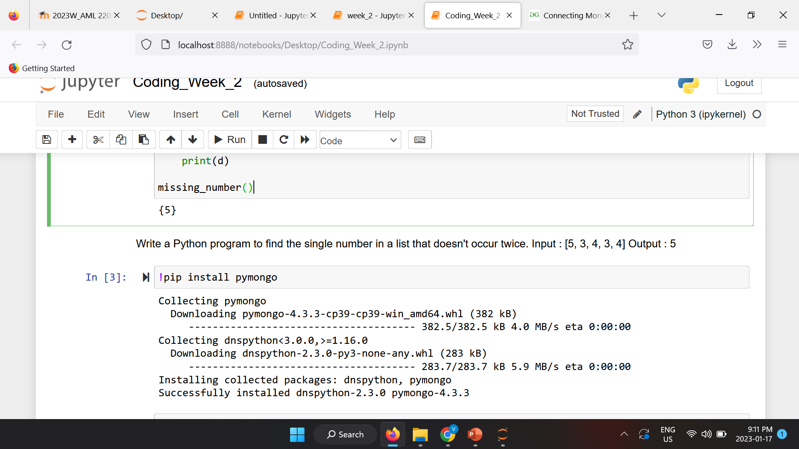
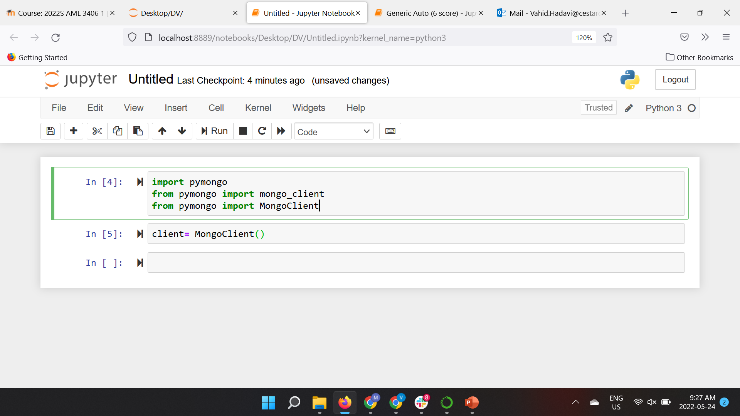
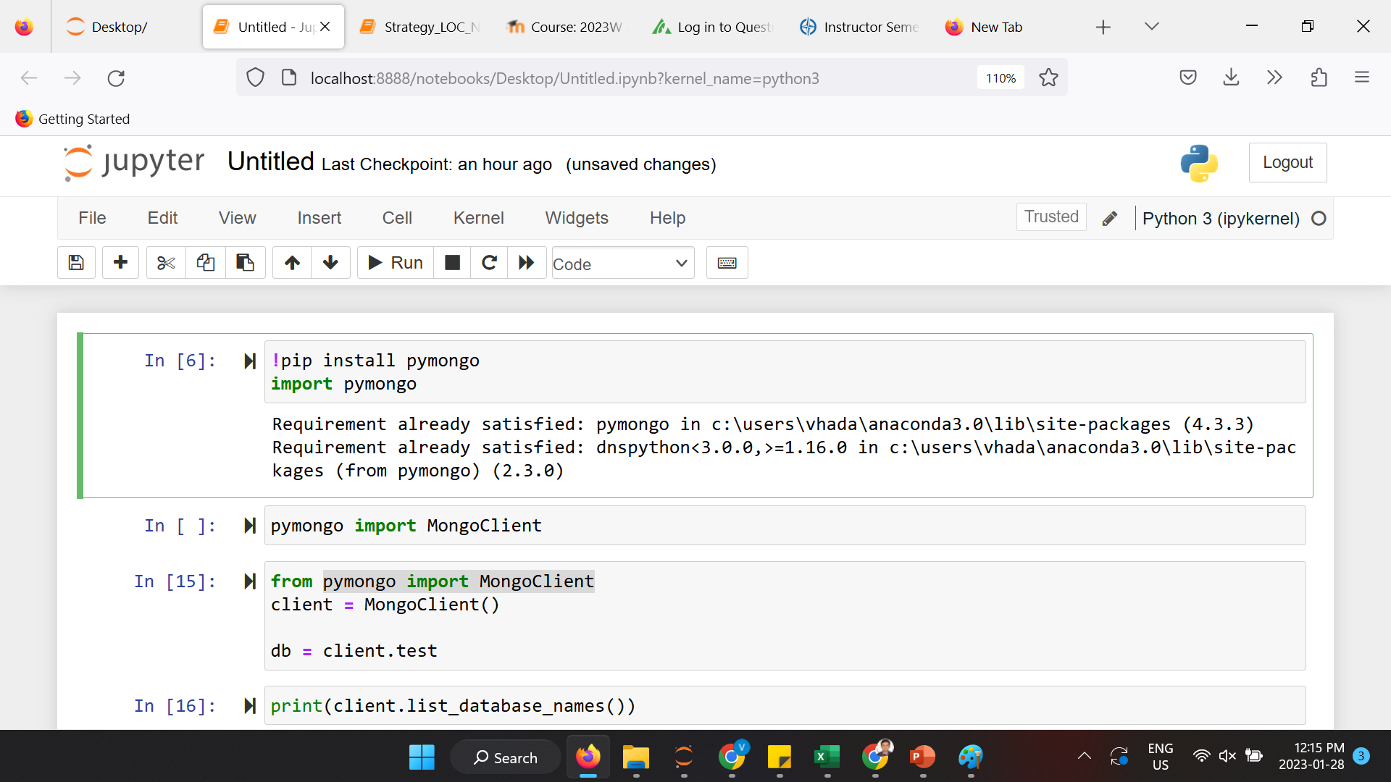
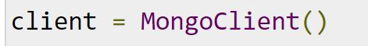
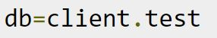
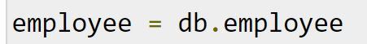
Python modules for NoSQL
In order to connect to MongoDB, Python uses a library known as pymongo.
It needs to be installed using pip.
After importing we can choose a client and connect to a database on it.
Next, we can have access to different collections on the connected database.

Slide 21
2.5 Explore CRUD operations using Python and non-relational database

Slide 22
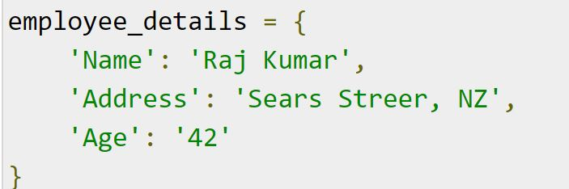
Insert one record
To insert a ‘record’, or ‘document’ as it is called in MongoDB, into a ‘collection’, we use the insert_one() method.
The first parameter of the insert_one() method is a dictionary containing the name(s) and value(s) of each ‘field’ in the document we want to insert.

Slide 23
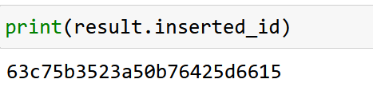
Return the _id Field
The insert_one() method returns a InsertOneResult object, which has a property, inserted_id, that holds the id of the inserted document.
If you do not specify an _id field, then MongoDB will add one for you and assign a unique id for each document.
In the example above no _id field was specified, so MongoDB assigned a unique _id for the record (document).

Slide 24
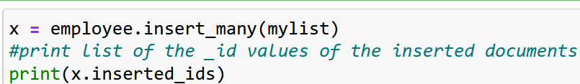
Insert Multiple Documents, (with Specified IDs)
To insert multiple documents into a collection in MongoDB, we use the insert_many() method.
The first parameter of the insert_many() method is a list containing dictionaries with the data you want to insert
If you do not want MongoDB to assign unique ids for you document, you can specify the _id field when you insert the document(s).
Remember that the values has to be unique. Two documents cannot have the same _id.
mylist = [{"_id":1,"name":"John","address":"Highway 37"},
{"_id":2,"name":"Peter","address":"Lowstreet 27"},
{"_id":3,"name":"Amy","address":“Close st 652"},
{"_id":4,"name":"Hannah","address":"Mountain 21"},
{"_id":5,"name":"Michael","address":"Valley 345"},
{"_id":6,"name": "Vicky", "address": "Yellow Garden 124"},
{"_id":7,"name": "Nicky", "address": "Yellow Garden 23"},
{"_id":8,"name": "Nancy", "address": "Younge Ave. 123"},
{"_id":9,"name": "Viola", "address": "Sideway Ave"}]

Slide 25
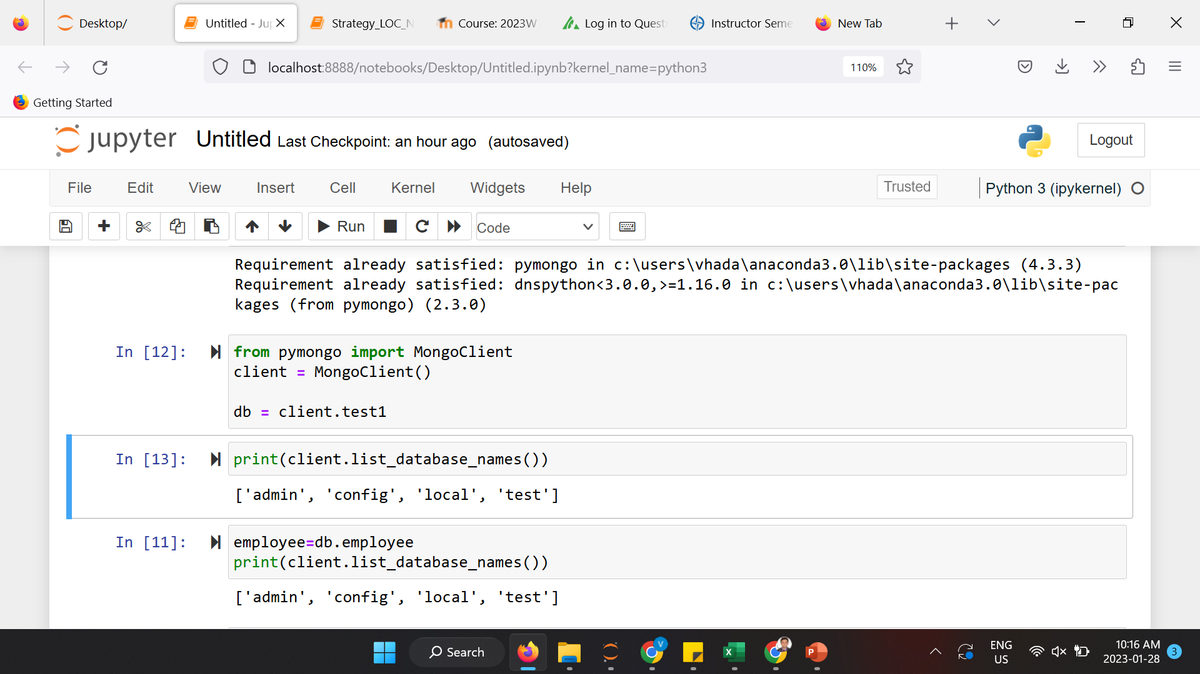
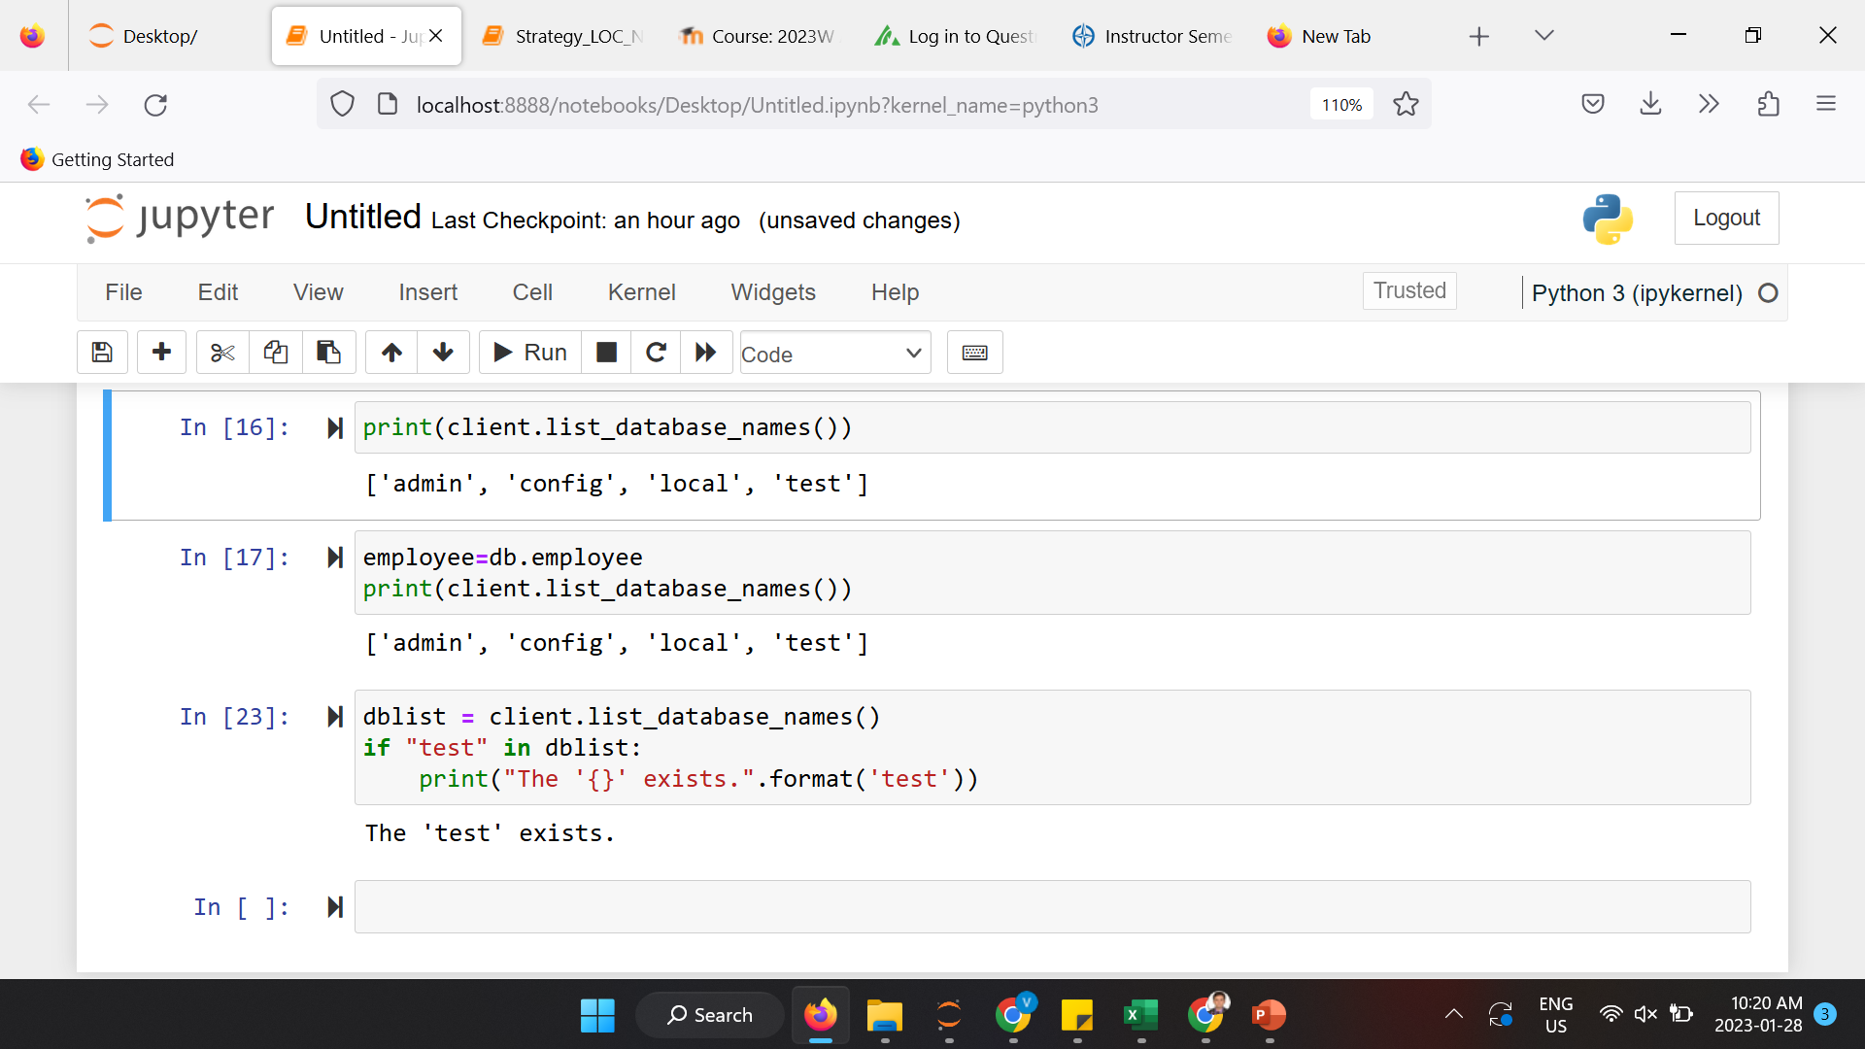
Check if Database Exists
You can check if a database exist by listing all databases in your system.
Or, you can check if a specific database exists by name, for exam the ‘test’ database created earlier :
In MongoDB, a database is not created until it gets content, so if this is your first time creating a database, you should create collection and create document before you check if the database exists!

Slide 26
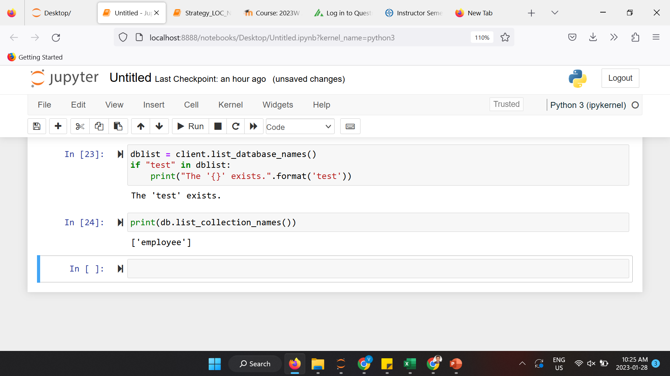
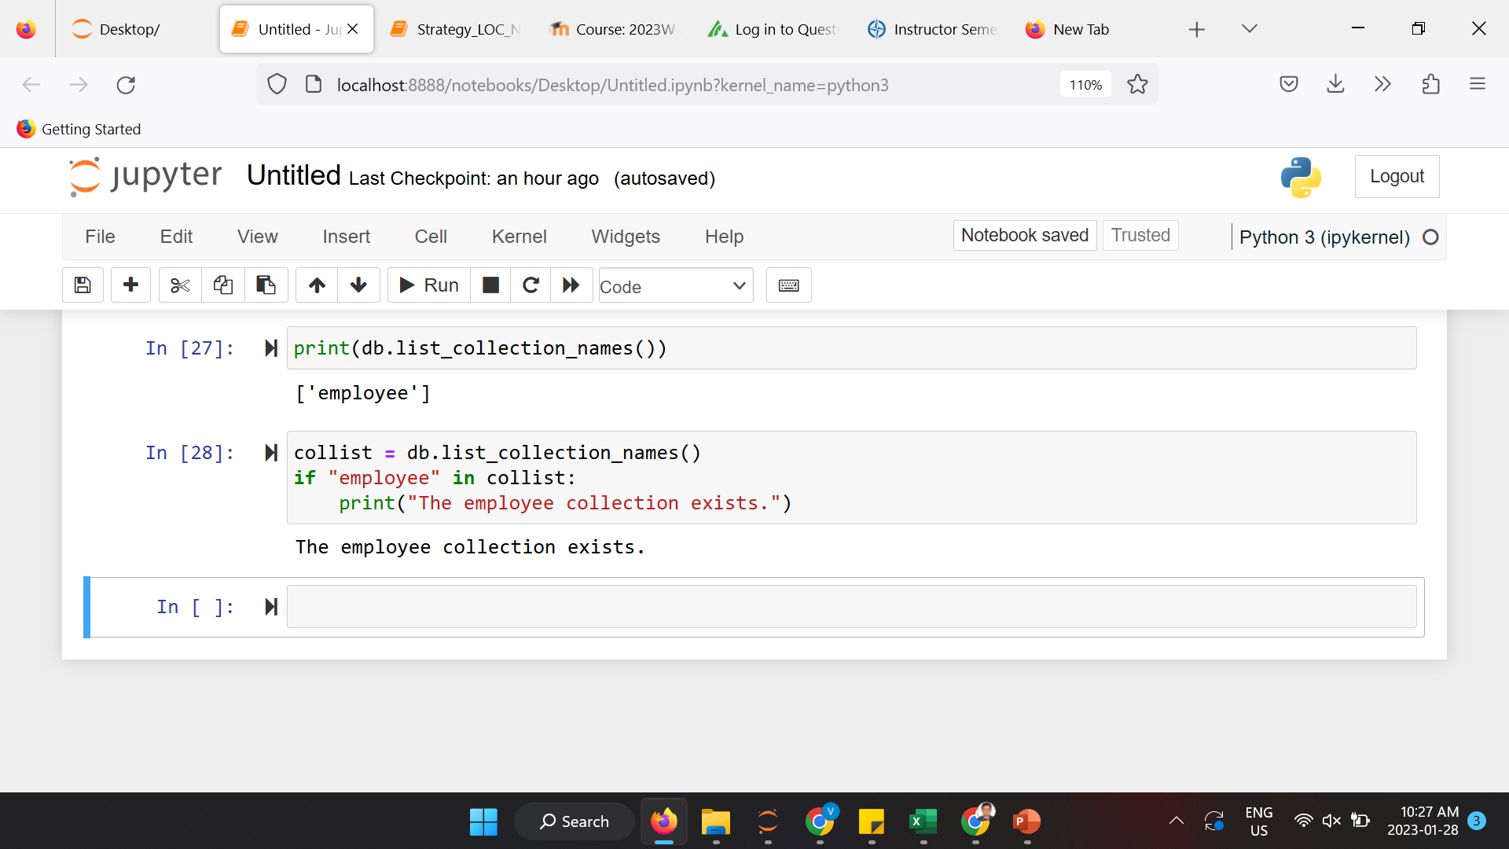
Check if Collection Exists
You can check if a collection exist in a database by listing all collections:
Example : Return a list of all collections in your database
Or you can check a specific collection by name:
Example : Check if the “employee” collection exists:
In MongoDB, a collection is not created until it gets content, so if this is your first time creating a collection, you should create document before you check if the collection exists!

Slide 27
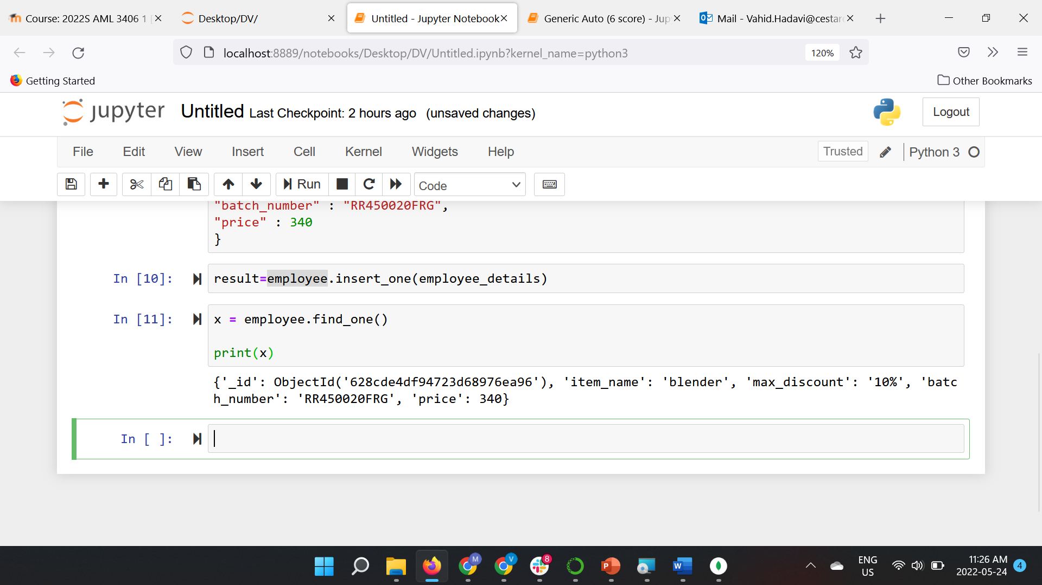
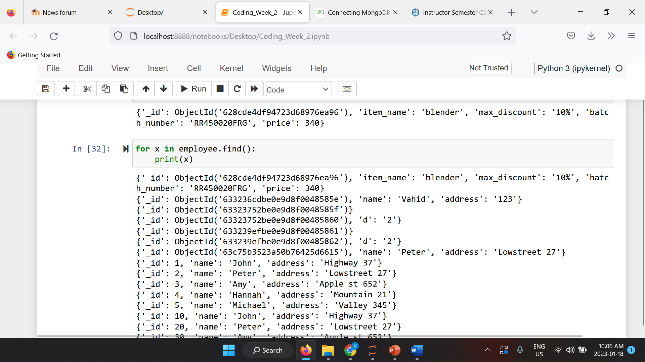
Read one record
Read all records

Slide 28
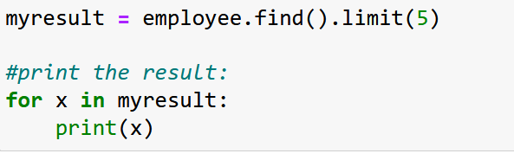
Read (Limit the Result)
To limit the result in MongoDB, we use the limit() method.
The limit() method takes one parameter, a number defining how many documents to return.
Example : Limit the result to only return 5 documents
Challenge question : Try getting the same output, ‘without’ using the ‘limit’ method !

Slide 29
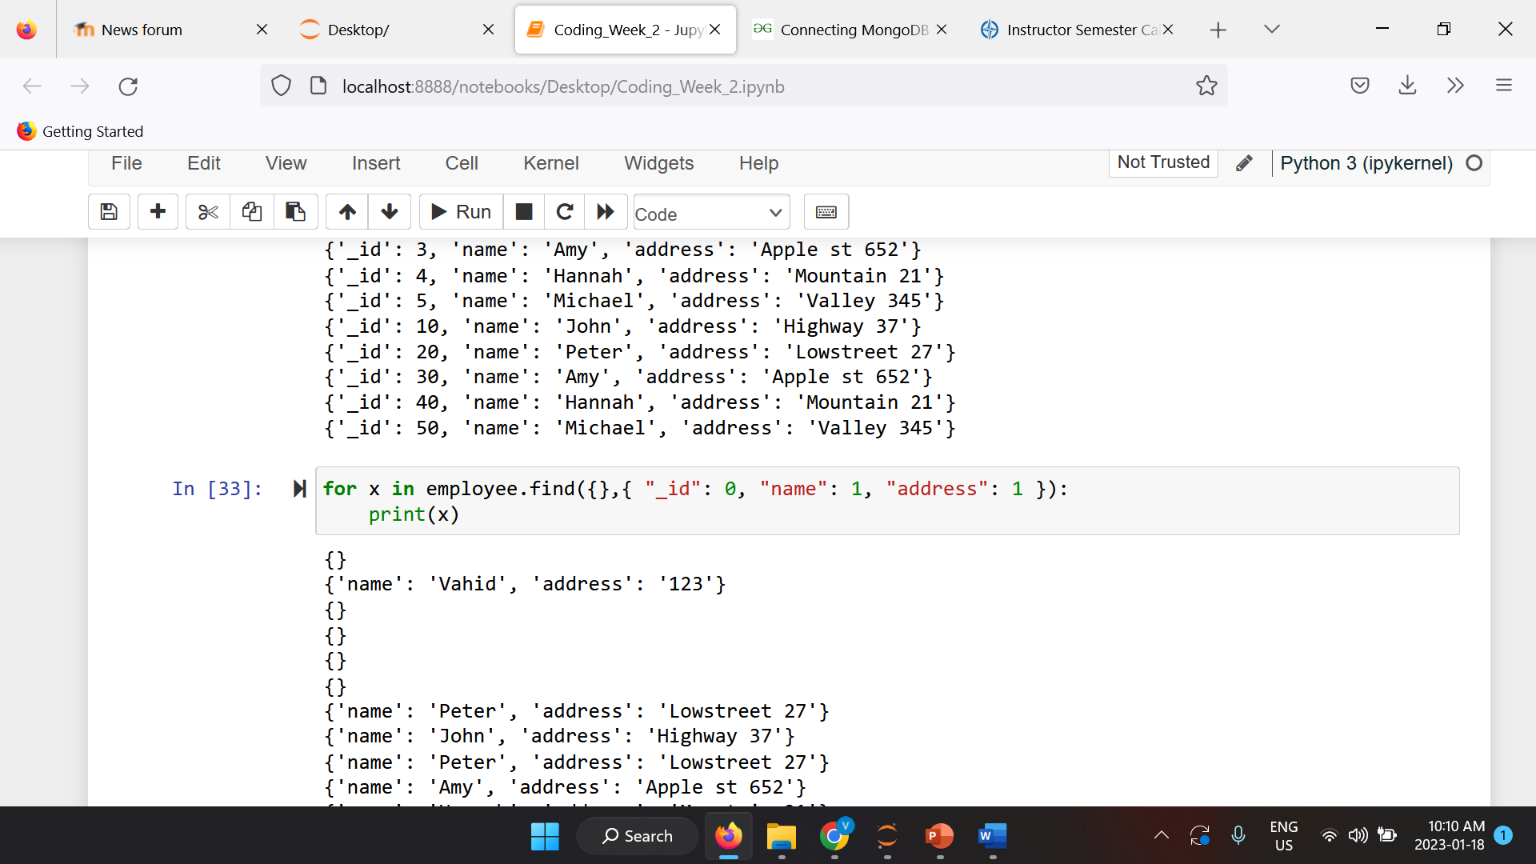
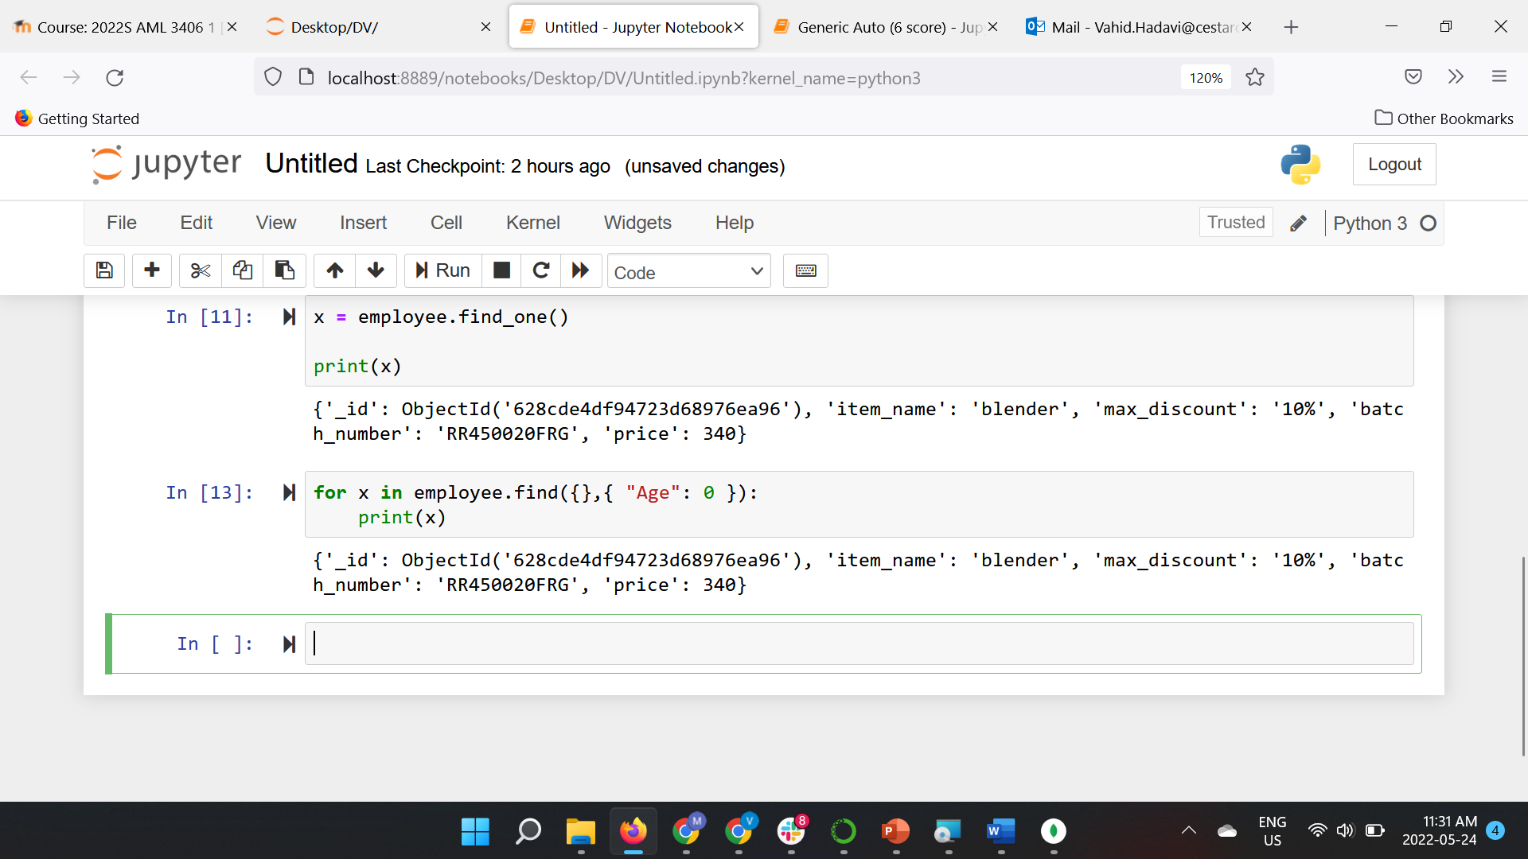
Return Only Some Fields
The first parameter of the find() method is a query object which specifies the documents to be selected.
In this example we use an empty query object, which selects all documents (entries) in the collection
The second parameter of the find() method is an object describing which fields to include in the result.
This parameter is optional, and if omitted, all fields will be included in the result.
Example : Return only the names and addresses, not the _ids
Print all fields except “Age”

Slide 30
Advanced MongoDB Query

Slide 31
Advanced MongoDB Query
(Filter the output documents)
What is a MongoDB Query?
MongoDB query is used to specify the selection filter using query operators while retrieving the data from the collection by db.find() method.
Using this method, we can easily filter the documents using the query object.
To apply the filter on the collection, we can pass the query specifying the condition for the required documents as a parameter to this method, which is an optional parameter for .find() method.

Slide 32
Advanced MongoDB Query
(Query Selectors)
Query Selectors: Following table is the list of some operators used in the queries in MongoDB.
Operation | Syntax | Description
Equality | {“key” : “value”} | Matches values that are equal to a specified value.
Less Than | {“key” :{$lt:”value”}} | Matches values that are less than a specified value.
Greater Than | {“key” :{$gt:”value”}} | Matches values that are greater than a specified value.
Less Than Equal to | {“key” :{$lte:”value”}} | Matches values that are less than or equal to a specified value.
Greater Than Equal to | {“key” :{$gte:”value”}} | Matches values that are greater than or equal to a specified value.
Not Equal to | {“key”:{$ne: “value”}} | Matches all values that are not equal to a specified value.
Logical AND | { “$and”:[{exp1}, {exp2}, …, {expN}] } | Joins query clauses with a logical AND returns all documents that match the conditions of both clauses.
Logical OR | { “$or”:[{exp1}, {<exp2}, …, {expN}] } | Joins query clauses with a logical OR returns all documents that match the conditions of either clause.

Slide 33
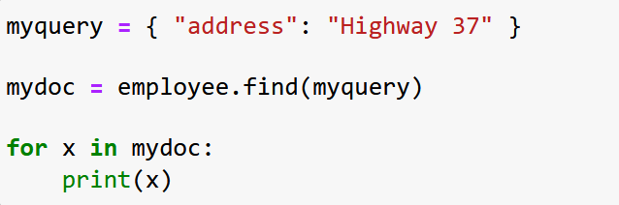
Python MongoDB Query : Equality operator
When finding documents in a collection, you can filter the result by using a query object.
The first argument of the find() method is a query object, and is used to limit the search
The ‘Equality’ operator matches values that are equal to a specified value.
Example : Find document(s) with the address “Highway 37
Challenge question : Imagine we have multiple documents where the address is “Highway 37“; modify the code above to get only the last 2 documents that satisfy the query above!

Slide 34
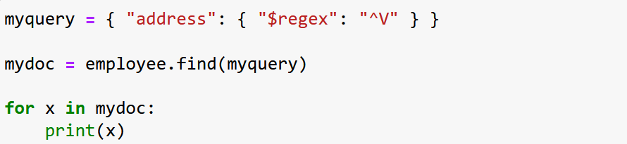
Filter With Regular Expressions
(Equality operator using regex)
You can also use regular expressions as a modifier.
Regular expressions can only be used to query strings.
To find only the documents where the "address" field starts with the letter “V", use the regular expression {"$regex": "^V"}:
Example : Find documents where the address starts with the letter “V"
Challenge question : write a query that prints all records having the letter ‘l’ (it’s L in lower case ) in their address field !

Slide 35
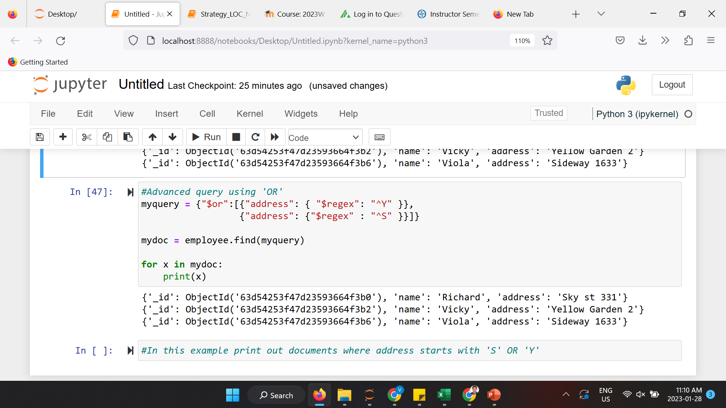
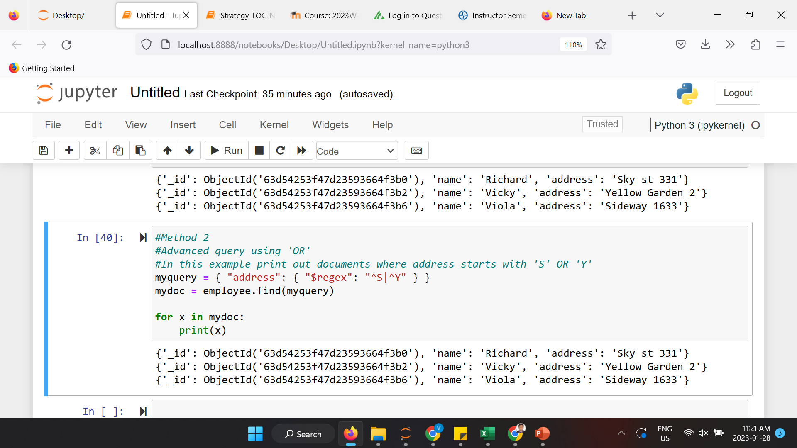
Advanced MongoDB Query : Logical ‘OR’
This operator joins query clauses with a logical OR. This returns all documents that match the conditions of either clause.
myquery ={ “$or”:[{exp1}, {<exp2}, …, {expN}] }
Example : print out documents where address starts with 'S' OR ‘Y’
Alternative method :

Slide 36
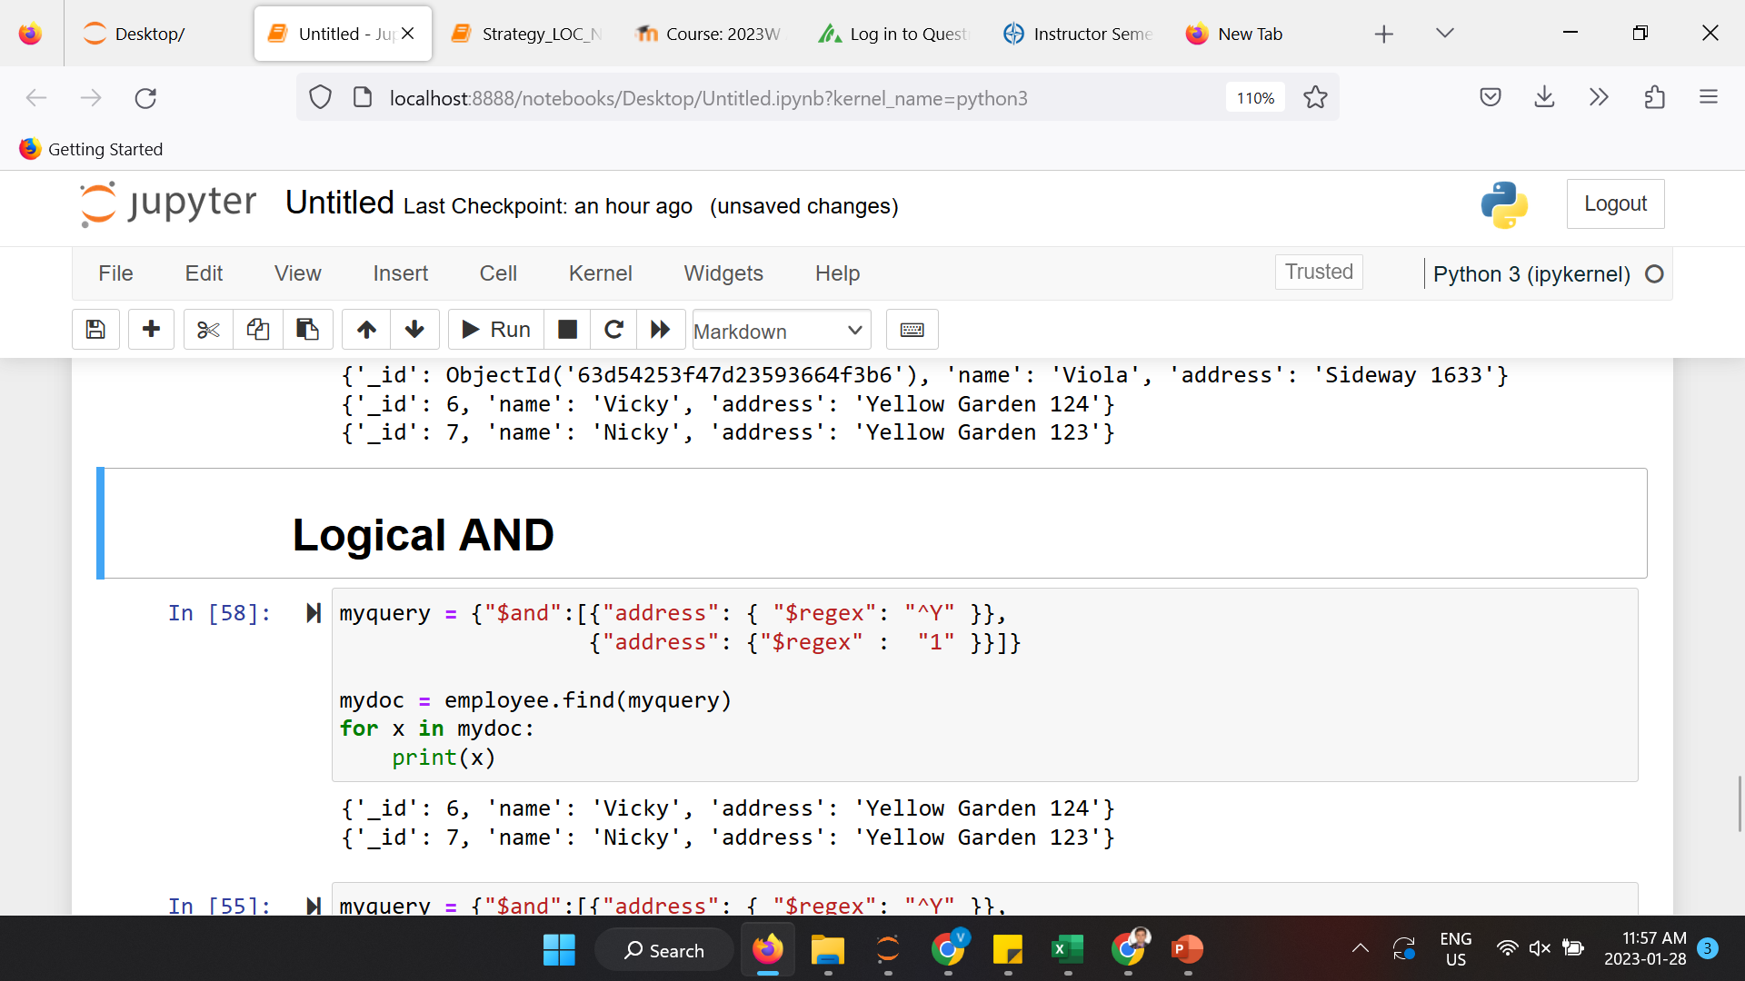
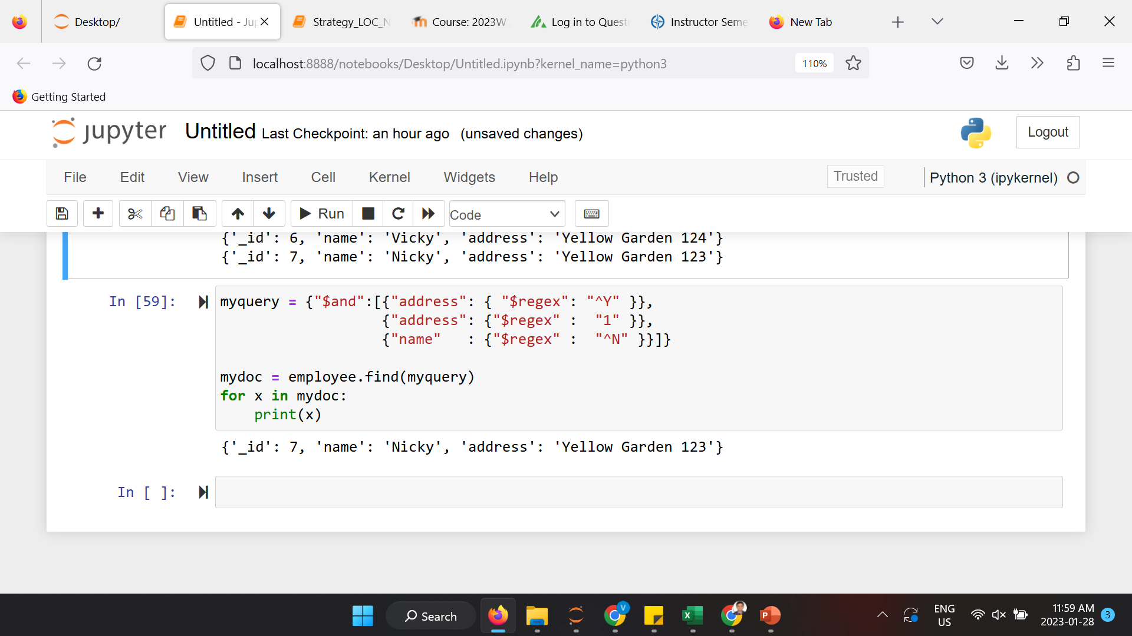
Advanced MongoDB Query : Logical ‘AND’
This method joins query clauses with a logical AND . It returns all documents that match the conditions of ALL clauses.
myquery = { “$and”: [ {exp1}, {exp2}, …, {expN} ] }
Example : print out documents where address field starts with ‘Y’ AND have ‘1’ in the address field
Example : print out documents where address field starts with ‘Y’ AND have ‘1’ in the address field AND the name field start with ‘N

Slide 37
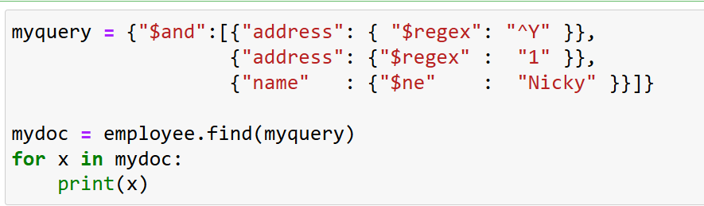
Advanced MongoDB Query : Logical ‘NOT EQUAL’
This method matches all values that are not equal to a specified value.
myquery = {“key”:{$ne: “value”}}
Example : print out documents where address field starts with ‘Y’ AND have ‘1’ in the address field AND the name field NOT EQUAL TO ‘Nicky’

Slide 38
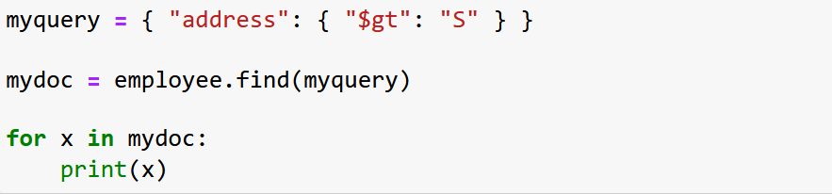
Advanced MongoDB Query : ‘Greater Than’
This operator matches values that are greater than a specified value
E.g. to find the documents where the "address" field starts with the letter "S" or higher (alphabetically), use the ‘greater than’ modifier: {"$gt": "S"}
Example: find documents where the address starts with the letter "S" or higher:
Challenge question : Experiment $lt, $lte, $gte using other fields

Slide 39
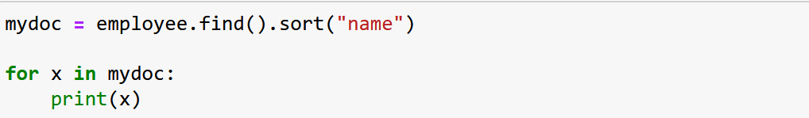
Python MongoDB Sort
Sort the Result:
Use the sort() method to sort the result in ascending or descending order.
The sort() method takes one parameter for "fieldname" and one parameter for "direction" (ascending is the default direction).
Sort Descending :
Use the value -1 as the second parameter to sort descending.
Example :
sort("name", 1) #ascending sort("name", -1) #descending

Slide 40
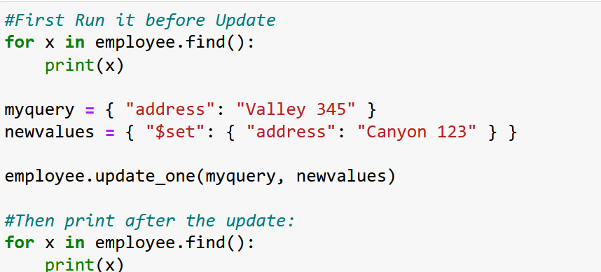
Update one record
You can update a record, or document as it is called in MongoDB, by using the update_one() method.
The first parameter of the update_one() method is a query object defining which document to update.
Note: If the query finds more than one record, only the first occurrence is updated.
The second parameter is an object defining the new values of the document.
Example : Change the address from "Valley 345" to "Canyon 123"

Slide 41
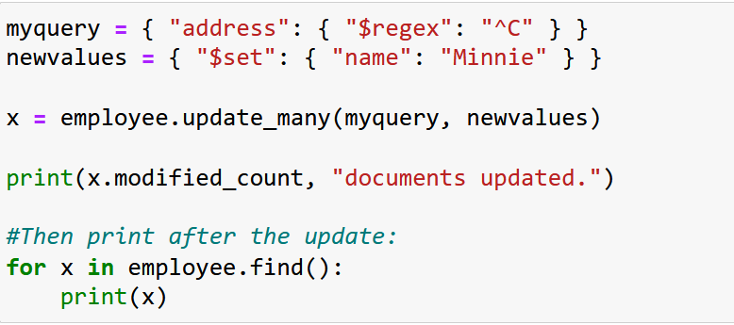
Update many record
To update all documents that meets the criteria of the query, use the update_many() method.
Example : Update all documents where the address starts with the letter “C"

Slide 42
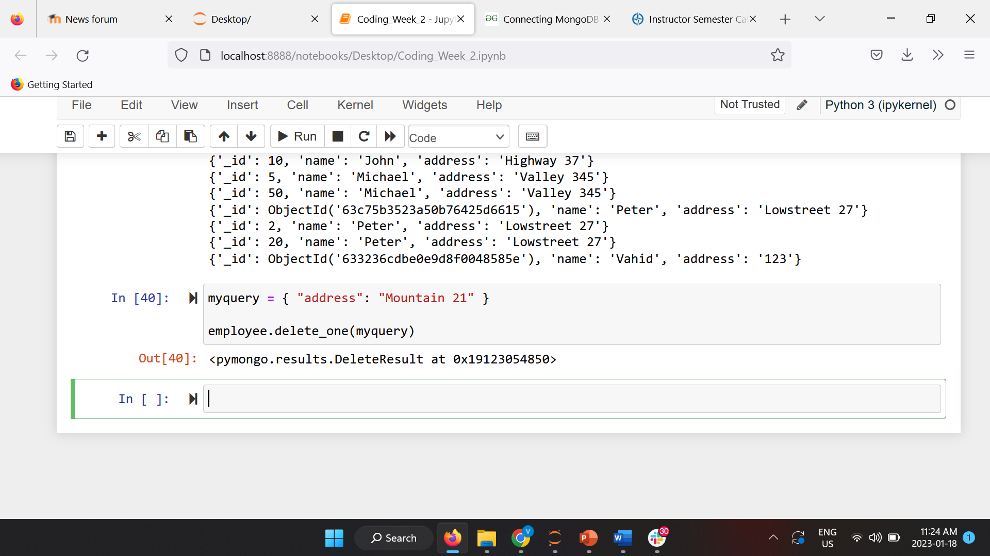
Delete One Document
To delete one document, we use the delete_one() method.
The first parameter of the delete_one() method is a query object defining which document to delete.
You can also define your query and insert that in the delete_one()
Note: If the query finds more than one document, only the first occurrence is deleted.
Example : Delete the document with the address "Mountain 21":

Slide 43
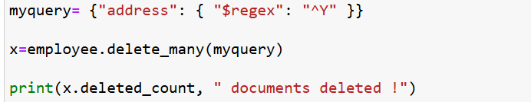
Delete Many Documents
To delete more than one document, use the delete_many() method.
The first parameter of the delete_many() method is a query object defining which documents to delete.
Example : Delete all documents were the address starts with the letter Y

Slide 44
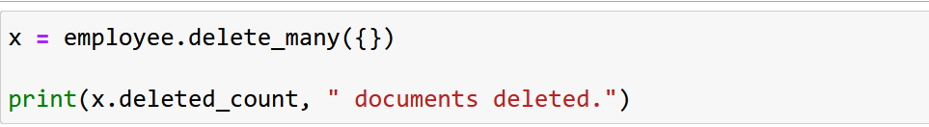
Delete All Documents in a Collection
To delete all documents in a collection, pass an empty query object to the delete_many() method
Example : Delete all documents in the collection

Slide 45
Drop Collection
You can drop the whole collection using : collection_name.drop()

Slide 46
Any questions so far? Any comments?

